Slide 1
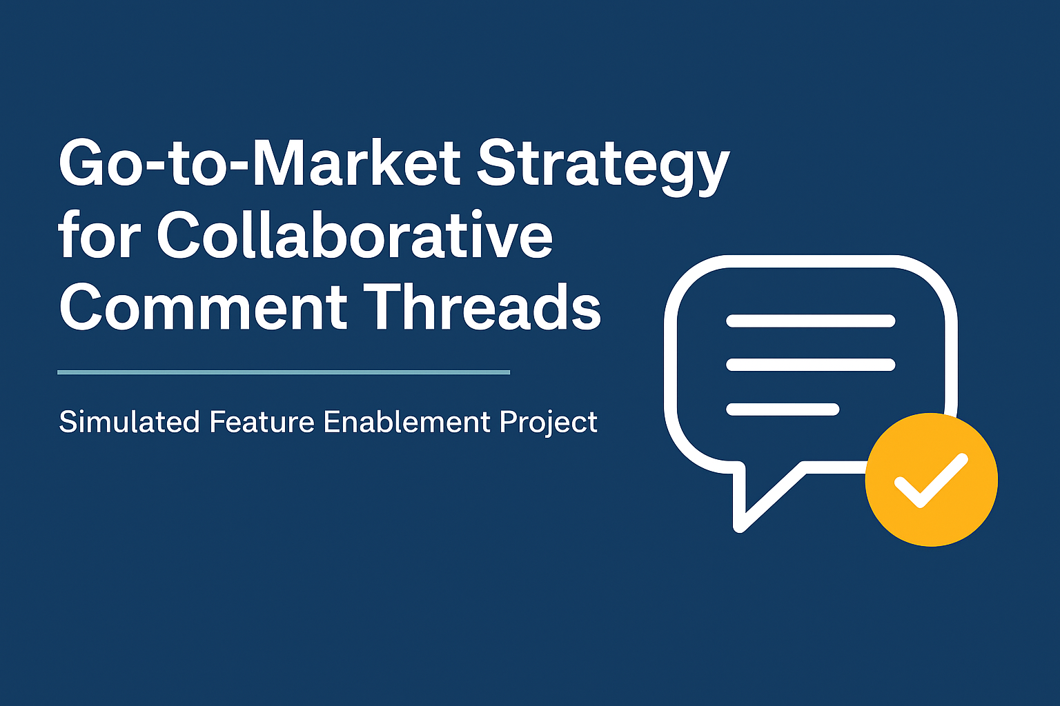
Presented By - Shaik Muffazzalin Taj

Slide 2
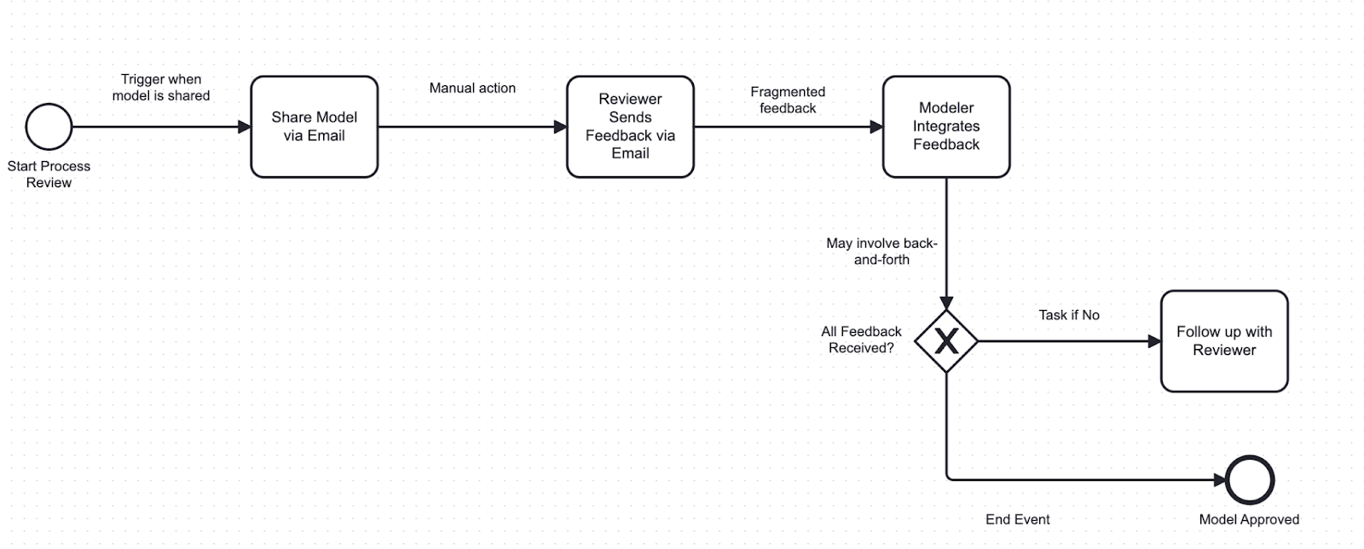
Current Feedback Workflow (AS-IS) – Fragmented and Slow
Designed using BPMN.io
AS-IS: Manual, Un-structured feedback via external tools. Modelers rely on emails and follow-ups to collect responses

Slide 3
Current Feedback Workflow (AS-IS) – Fragmented and Slow
Pain Points
Feedback on models is shared via email or chat, not in the modelling tool
Review cycles are delayed due to follow-ups and miscommunication
Approvals depend on scattered, untracked actions
Modeller has to integrate feedback and follow up if it’s incomplete

Slide 4
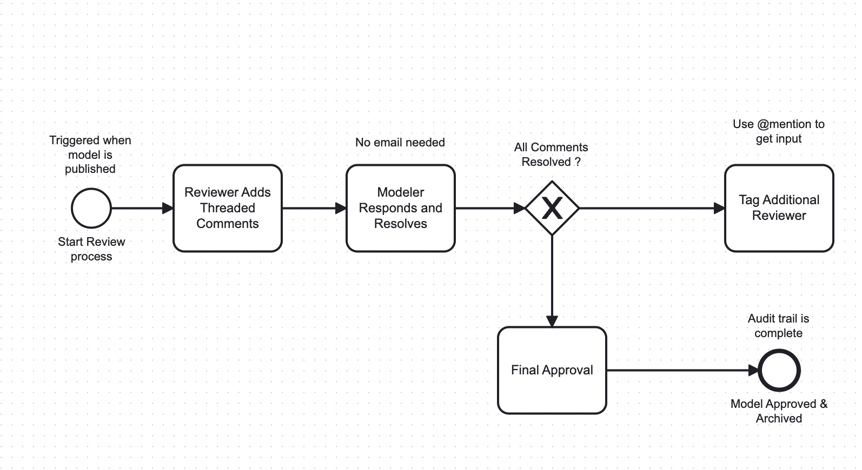
Future Feedback Workflow (TO-BE) – Structured and Efficient
TO-BE: Feedback loop moves inside the modelling tool via threaded comments - streamlining collaboration and accelarating approvals

Slide 5
Future Feedback Workflow (TO-BE) – Structured and Efficient
Improved Points
Reviewers add feedback directly within the model using threaded comments
Modelers can respond and resolve comments without leaving the tool
Enables faster approval and accountability with full audit trail
Eliminates email dependency and fragmented communication

Slide 6
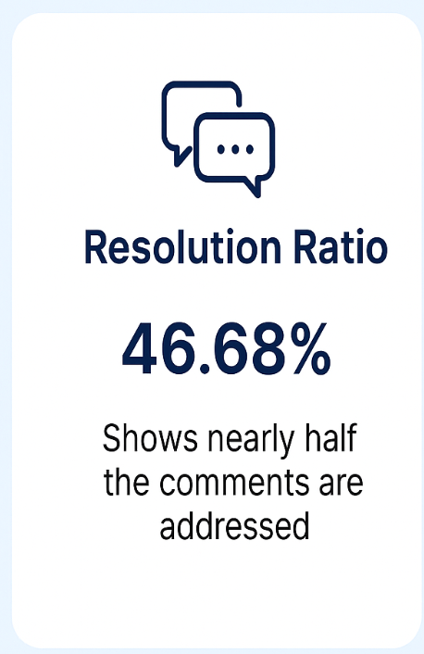
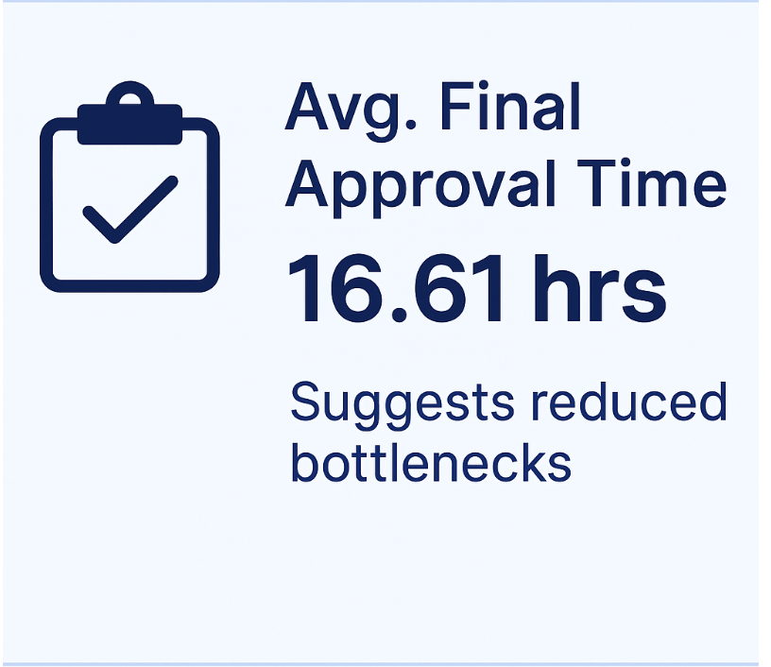
Early KPI Signals from Structured Feedback Implementation
Initial usage of the threaded comments feature shows promising signs of improved model collaboration. These KPIs establish a baseline to evaluate impact over time. The below KPIs are calculated in Excel on Sample data of threaded comments feature workflow.

Slide 7
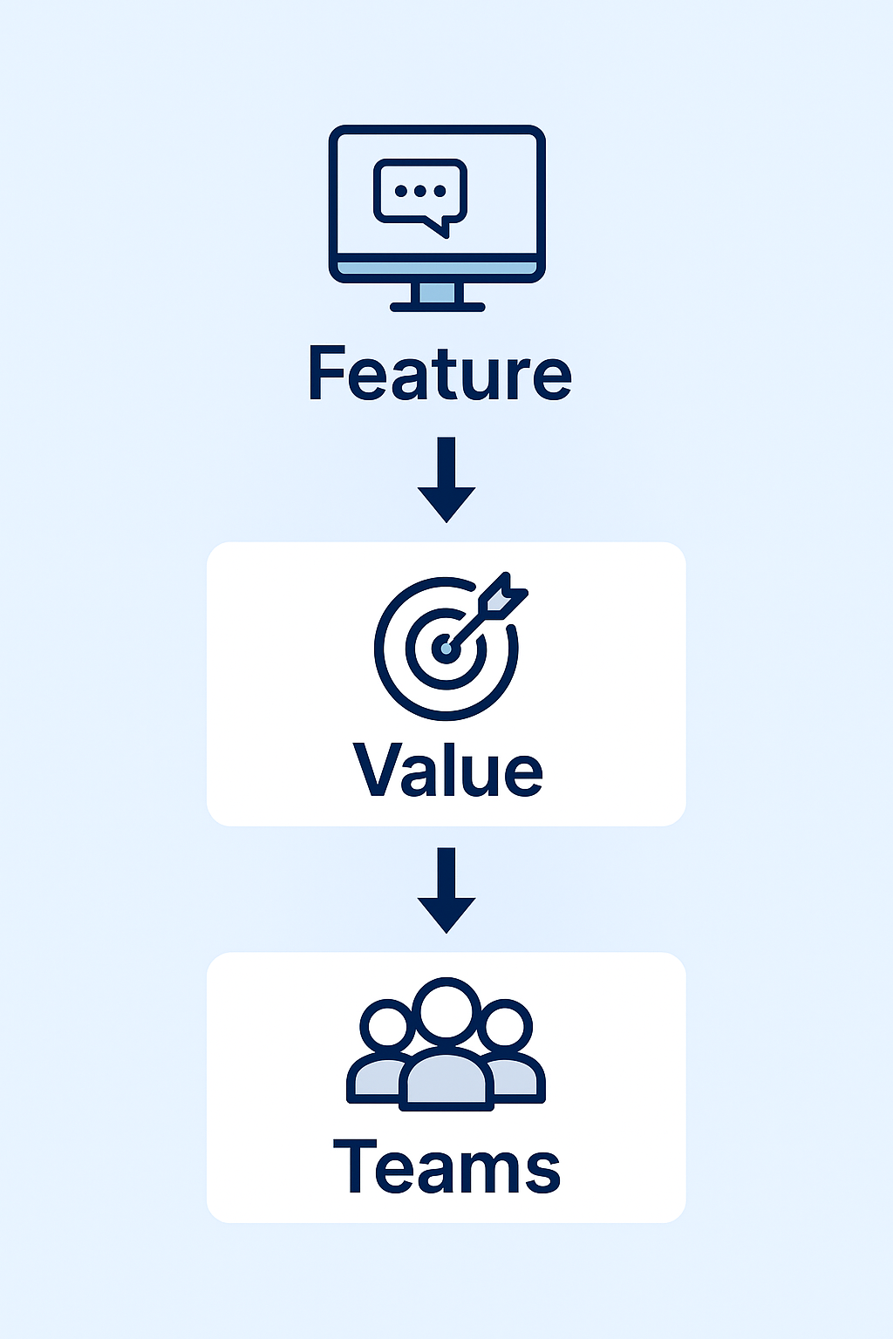
Feature Launch Summary & Go-To-Market Pitch
Feature Summary
Collaborative comment threads built directly into the modeling tool for faster, structured review and approvals.
Why it mattes
Eliminates email-based confusion
Reduces feedback cycles
Builds accountability with an audit trail
Target Users & Teams
Modelers
Reviewers

Slide 8
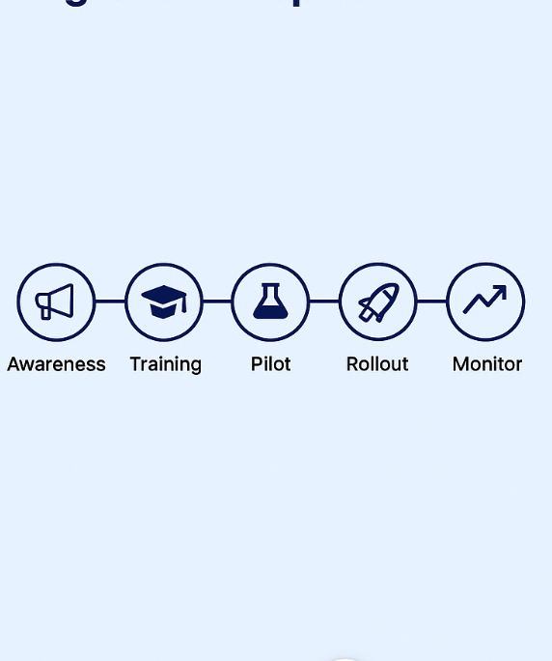
Enablement Journey – Driving User Adoption
Awareness Phase
Share feature update via internal release notes, demos, and newsletters
Training Phase
Conduct enablement sessions or tutorials for modelers and reviewers
Pilot Launch Phase
Test feature with a selected group of users and collect feedback
Organization-Wide Rollout Phase
Enable feature for all users based on pilot insights
Monitoring & Support Phase
Track KPIs, provide ongoing guidance, iterate based on user feedback

Slide 9
Next Steps & Recommendations
Collect more feedback from wider user base post-launch
Track long-term KPIs like resolution ratio trends, user satisfaction
Enable commenting analytics to identify top pain points per model
Consider feature enhancements like comment tagging by topic or priority
Scale enablement content to new teams and global locations

Slide 10
Project Summary & Acknowledgments
Simulated the end-to-end feature enablement process
Modeled AS-IS and TO-BE workflows to highlight improvement
Built KPIs to validate feature effectiveness
Created real-world stakeholder presentation skills

Slide 11
Thank You!

